Slide 1

How Software is helping with Covid-19 Machine Learning and Azure

Slide 2
What we talk about
Understand Machine Learning in Azure, and how to apply to something real.
For this we need to do the follow
Define the problem (What is the result that we want, and how we will do it)
We need to choose a key indicator.
Stablish an evaluation protocol and check the different existent protocols.
We need to prepare the data (what type of data we will use)
Divide, extract the data
Develop a reference model and use the right.

Slide 3
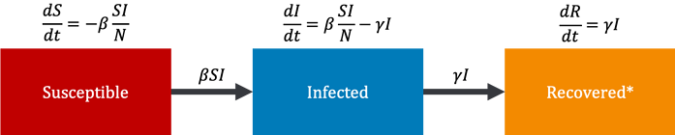
SIR MODEL
https://www.blue-granite.com/blog/sir-modeling-on-azure-covid-19-hospital-impact-model-for-epidemics

Slide 4
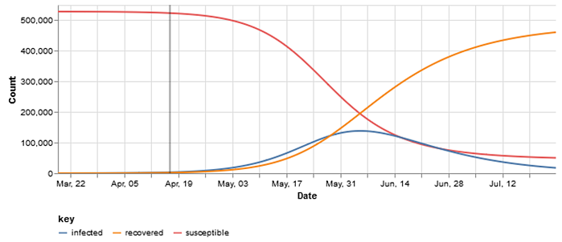
SIR MODEL
These types of models can give us a couple different curves that measure slightly different things such as:
the number of daily admissions into a hospital
the total number of people in the hospital with COVID-19 (which we call the census view)
or the proportion of the population that fits into one of these SIR states over time
https://www.blue-granite.com/blog/sir-modeling-on-azure-covid-19-hospital-impact-model-for-epidemics

Slide 5
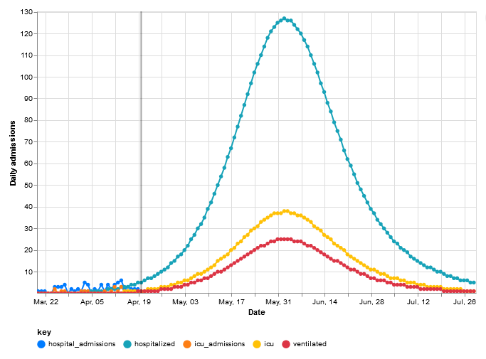
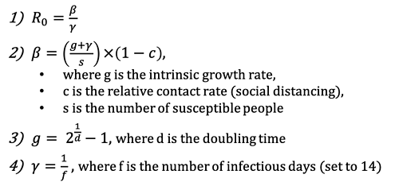
Flattening the Curve
https://www.blue-granite.com/blog/sir-modeling-on-azure-covid-19-hospital-impact-model-for-epidemics

Slide 6
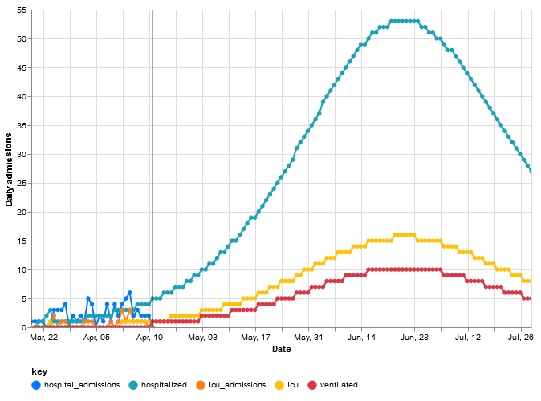
Flattening the Curve
In this example above, 30% social distancing mitigation cuts the R₀ of 3.59 down to the R_{t} which is 2.51. That means that we go from infecting over three people each, to just between two and three each. For this particular population, it also puts the peak of the infected curve to the end of May.
Next, let us see what happens if we bump up the amount of people that are social distancing; that is to say, the percentage of the population that follows the rules and stays home (hopefully all of us!).
https://www.blue-granite.com/blog/sir-modeling-on-azure-covid-19-hospital-impact-model-for-epidemics

Slide 7
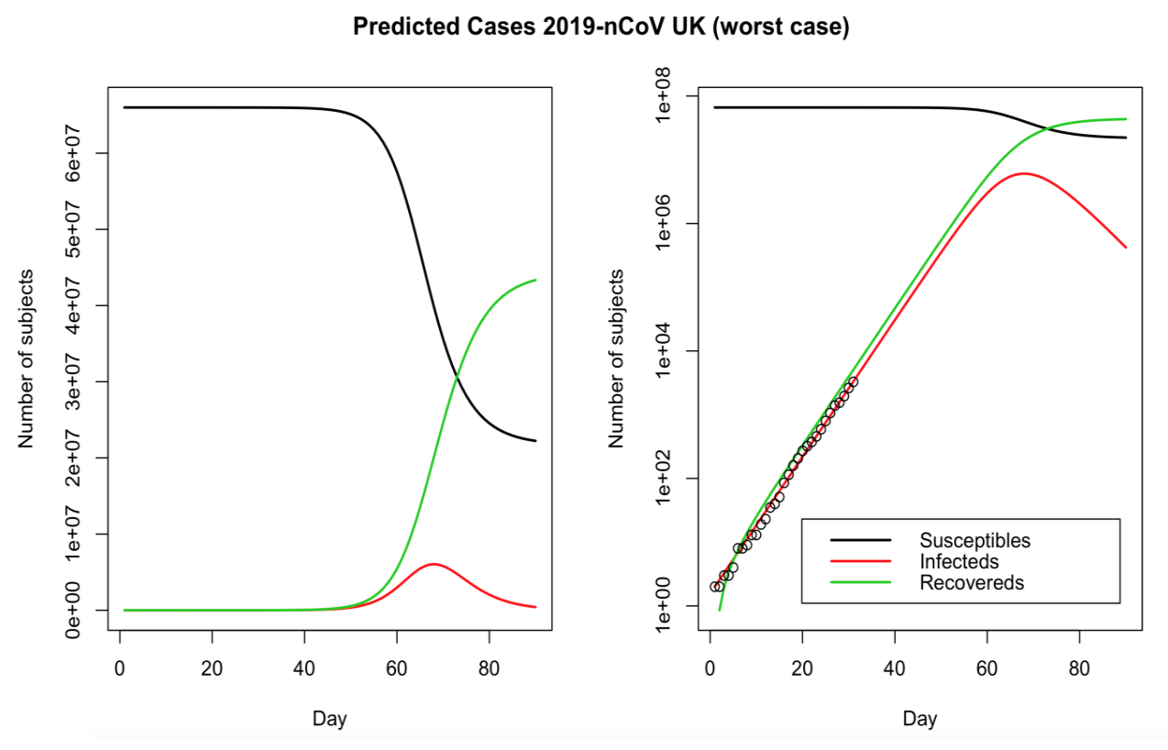
Epidemic modelling of COVID-19 in the UK using an SIR model
Published by Thomas Wilding, this blog post applies the SIR model to UK data.
As further extensions to the model, the author suggests:
Using an SEIR model (adding an Exposed compartment for people who are infected but not yet infectious)
Adding a “Q” layer since a lot of people are being Quarantined or isolated
Considering the “hidden”” population that is infected but is denied being tested due to shortage of tests
Feasibility of a second wave / outbreak of the epidemic later in the year (as seen in previous outbreaks, such as Swine Flu)
Data sources:
Wikipedia
Worldometers
The Guardian
https://towardsdatascience.com/top-5-r-resources-on-covid-19-coronavirus-1d4c8df6d85f

Slide 8
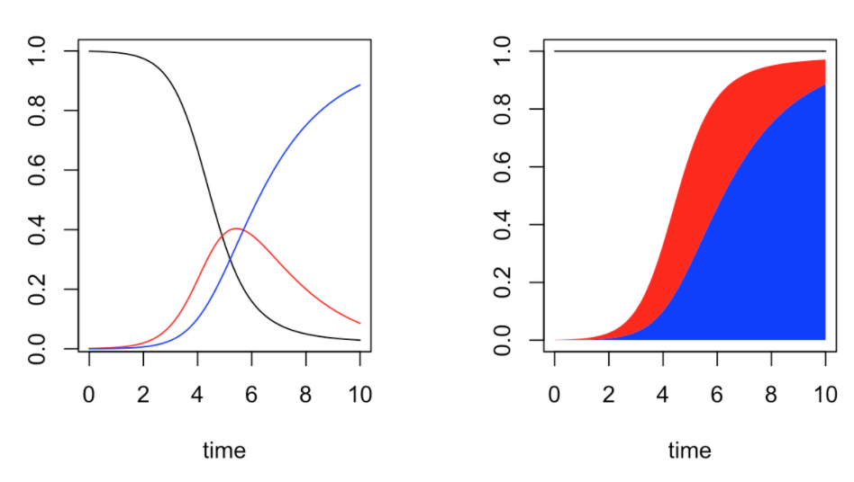
Modeling Pandemics
Published by Arthur Charpentier, this series of 3 blog post (part 1, part 2, part 3) walks through the SIR model and its parameters, how ODEquations solves it, and generating the reproductive rate. It also gives a mathematical explanation of a model for how quickly a pandemic will return, albeit with diminishing intensity. Last, it explains a model that is more sophisticated than SIR, the SEIR model, and illustrates it with Ebola data.
More recently, the author published another article which examines what proportion of the population in various U.S. states have been tested for the novel coronavirus and tries to answer the following two questions:
How many people are tested on a daily basis?
What are we actually testing for?
https://towardsdatascience.com/top-5-r-resources-on-covid-19-coronavirus-1d4c8df6d85f

Slide 9
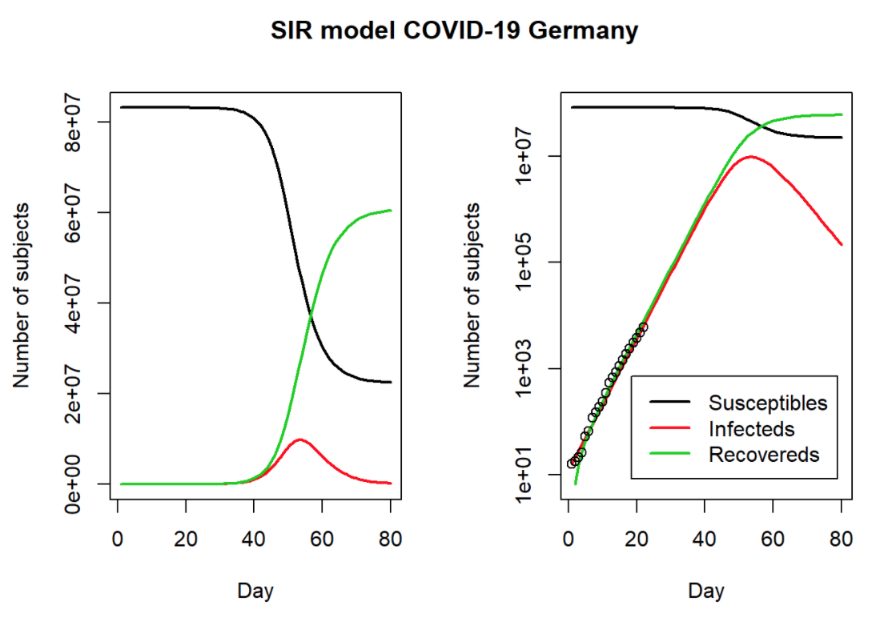
COVID-19: The Case of Germany
Published by Prof. Dr. Holger K. von Jouanne-Diedrich from Learning Machines, this blog post uses the SIR model and German data to estimate the duration and severity of the pandemic.
Download the data from Morgenpost.
More recently, the author published two other articles:
COVID-19 in the US: Back-of-the-Envelope Calculation of Actual Infections and Future Deaths: Working back from reported deaths from Covid19, the post shows how to estimate infections at a prior date, based on several assumptions about fatality rates and infected periods (and acknowledging many unknowns and data problems).
How to analyze mobility trends with R using anonymized and aggregated Apple’s mobility data available to the public.
https://towardsdatascience.com/top-5-r-resources-on-covid-19-coronavirus-1d4c8df6d85f

Slide 10
CHIME Model
The CHIME (COVID-19 Hospital Impact Model for Epidemics) Application is designed to assist hospitals and public health officials with understanding hospital capacity needs as they relate to the COVID pandemic. CHIME enables capacity planning by providing estimates of total daily (i.e. new) and running totals of (i.e. census) inpatient hospitalizations, ICU admissions, and patients requiring ventilation. These estimates are generated using a SIR (Susceptible, Infected, Recovered) model, a standard epidemiological modeling technique. Our model has been validated by several epidemiologists including Michael Z. Levy, PhD, Associate Professor of Epidemiology, Department of Biostatistics, Epidemiology and Informatics at the Perelman School of Medicine.
https://github.com/CodeForPhilly/chime
https://coronavirus-resources.esri.com/datasets/37ad6eb0d1034cd58844314a9b305de2
https://codeforphilly.github.io/chime/

Slide 11
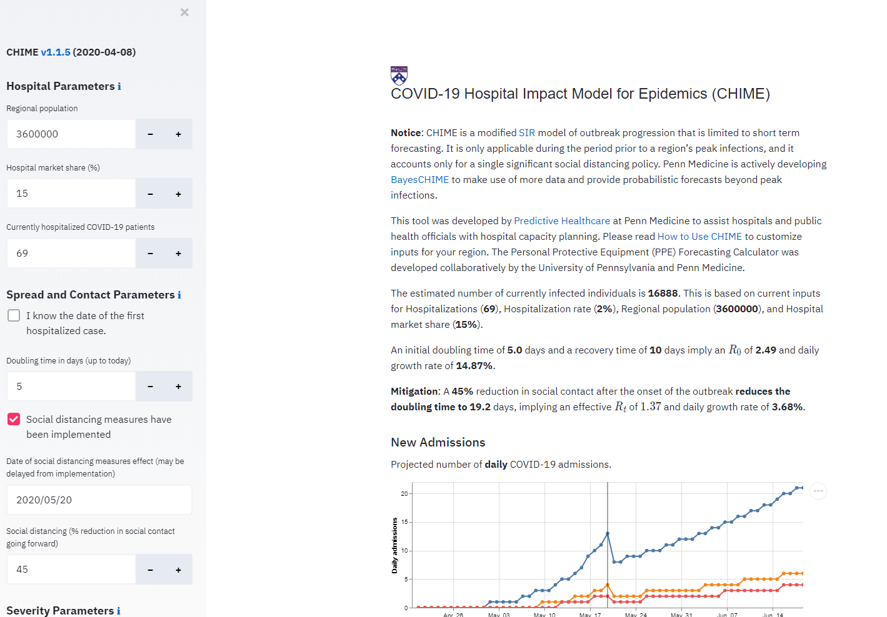
CHIME v1.1.5 (2020-04-08)
CHIME is a modified SIR model of outbreak progression that is limited to short term forecasting. It is only applicable during the period prior to a region’s peak infections, and it accounts only for a single significant social distancing policy. Penn Medicine is actively developing BayesCHIME to make use of more data and provide probabilistic forecasts beyond peak infections.

Slide 12
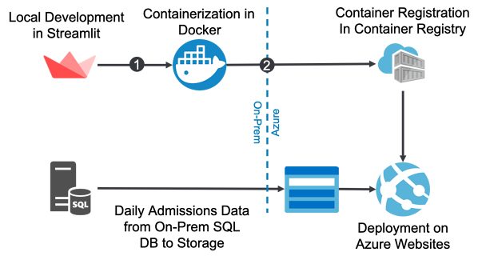

Deployment on Azure
The application itself is written in a web framework called Streamlit. Streamlit is a Python framework that's kind of like Django or Flask, but built simple modeling tasks with visual outputs, and it's what the original CHIME model was written in from the U Penn researchers. Our client needed the model customized quickly, so that is what we used for the project.

Slide 13
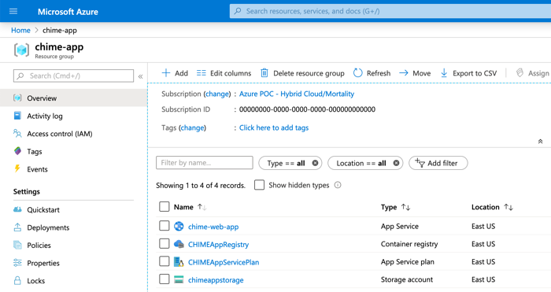

Slide 14
COVID-19 Open Research Dataset
Full-text and metadata dataset of COVID-19 and coronavirus-related scholarly articles optimized for machine readability and made available for use by the global research community.
In response to the COVID-19 pandemic, the Allen Institute for AI has partnered with leading research groups to prepare and distribute the COVID-19 Open Research Dataset (CORD-19), a free resource of over 47,000 scholarly articles, including over 36,000 with full text, about COVID-19 and the coronavirus family of viruses for use by the global research community.
This dataset is intended to mobilize researchers to apply recent advances in natural language processing to generate new insights in support of the fight against this infectious disease.
The corpus may be updated as new research is published in peer-reviewed publications and archival services like bioRxiv, medRxiv, and others.
https://azure.microsoft.com/en-us/services/open-datasets/catalog/covid-19-open-research/
https://azure.microsoft.com/en-us/services/open-datasets/catalog/
https://www.semanticscholar.org/cord19

Slide 15
Resources
University of Pennsylvania Medicine Chime Model: https://penn-chime.phl.io/
University of Washington IHME Model: https://covid19.healthdata.org/united-states-of-america
WBTV News Interview on COVID-19 Modeling: https://www.wbtv.com/2020/04/13/limited-data-makes-it-tough-model-coronaviruss-spread-experts-say/
https://www.youtube.com/watch?v=hMa5XPCjDDE
http://predictivehealthcare.pennmedicine.org/2020/03/14/accouncing-chime.html
https://www.zdnet.com/article/how-open-source-software-is-tackling-covid-19-coronavirus/
https://www.facebook.com/groups/670932227050506/permalink/673493760127686/
https://www.kaggle.com/allen-institute-for-ai/CORD-19-research-challenge
It uses the following data sources:
European Centre for Disease Prevention and Control
Public Health England
Blavatnik School of Government, Oxford University
https://towardsdatascience.com/top-5-r-resources-on-covid-19-coronavirus-1d4c8df6d85f

Slide 16
Data
2019 Novel Coronavirus COVID-19 (2019-nCoV) Data Repository by Johns Hopkins CSSE: : this dataset is used by many resources mentioned in this article and has become the gold standard for COVID-19 modeling
COVID-19 Open Research Dataset Challenge (CORD-19) (via Kaggle)
Novel Corona Virus 2019 Dataset: Day level information on covid-19 affected cases (via Kaggle)
COVID-19 Data from the European Centers for Disease Control
The COVID Tracking Project
Tidying the John Hopkins Covid-19 data to long format and merging some World Bank data
A Short Review of COVID-19 Data Sources
COVID-19 datasets by esri
beoutbreakprepared/nCoV2019: one of the very few non-aggregated dataset available online. Such a dataset of individual-level information on patients with confirmed COVID-19 (including their travel history, location, symptoms, reported onset and confirmation dates and basic demographics) is important to understand, among others, transmissibility, risk of geographic spread, routes of transmission and risk factors for infection.

